Slide 1
Sequential Digital Circuits
Alexander Titov
11 October 2014

Slide 2
Layers of Abstraction in Computes Science (CS)
Application
Algorithms
Programming Language
Operating System
Instruction Set Architecture
Microarchitecture
Topics of
this lecture
Gates/Register-Transfer Level (RTL)
Circuits
Physics

Slide 3
Refresher: Combinational vs. Sequential Circuits
If the output of a function is completely defined by the current input then the function is called combinational:
Qt = F(xt, yt, zt, …)
Combinational circuit (scheme) is an implementation of a combinational function
A lot of things can be implemented using combinational circuits
Just a few examples that we already know: summator, decoder, multiplexer
But, combinational circuits have a significant limitation:
But, combinational circuits have a significant limitation: they cannot remember any information

Slide 4
Sequential Circuits
Sequential circuits are able to store information
If the output of a function depends not only on the current input, but on the previous state, then the function is called sequential
Qt = F(xt, yt, zt, …, Qt-1)
Qt = F(xt, yt, zt, …, Qt-1)
F(xt-1, yt-1, zt-1, …, Qt-2))
F(xt-2, yt-2, zt-2, …, Qt-3)))
Sequential circuit is an implementation of a sequential function
Their main advantage is ability to remember the previous state
Any circuit with memory is a sequential circuits

Slide 5
SR Flip-Flop
The simplest store element:
SR flip-flop:
reset
SR flip-flop:
reset
Q
Q
Q
0
S | R | Qt-1 | Qt
1
0
1
0
0
Q
Q
!Q
0
1
Q
0
!Q
1
!Q
0
1
0
Q
1
1
0
set
set
1
1
Q
0
Prohibited state
0
1
NOR:
x
out
x
out
x | y | out
0 | 0 | 1
0 | 1 | 0
1 | 0 | 0
1 | 1 | 0
y
y
≡
≡
out
0
out
y

Slide 6
SR Flip-Flop
reset
Q
S | R | Qt-1 | Qt
0 | 0 | Q | Q
0 | 1 | Q | 0
1 | 0 | Q | 1
1 | 1 | Q | 0
R
Q
S
!Q
!Q
set
S
1
0
The output will be determined by the fastest signal
R
1
0
Q
1
But, which signal will be really faster will depend on many factors (e.g., temperature).
?
0
!Q
1
?
0

Slide 7
D Flip-Flop
Data
S
!Q
D
Q
D | we | Qt-1 | Qt
D | 0 | Q | Q
0 | 1 | Q | 0
1 | 1 | Q | 1
R
Q
we
Write enable
Don’t have prohibited states
Asserted by a level of the write enable signal (we)
Store one bit of information
Can be used as building block for creating static memory arrays

Slide 8
Trigger asserted by edge
Data
D
Q
D
Q
out
D | we | Qt-1 | Qt
D
0
Q
Q
we
we
D
1
Q
Q
Write enable
D
↑
Q
D
D
↓
Q
Q
Don’t open for writing neither at we =0 nor at we =1 as one of the triggers is closed
It is open for a very small amount of time when the write enable goes from 0 to 1
The value from the first trigger is written to the second trigger and then the first trigger is closed
It is a trigger asserted by the positive edge of write enable signal
Such types of triggers are mostly used to organize pipelined execution
D
Q
we

Slide 9
Single port 2^MxN Memory Array
address
M
Write enable
Memory
Array
N
N
input data
output data

Slide 10
Single port 4x1 Memory Array
address
2
Write enable
Memory
Array
1
1
input data
output data

Slide 11
Single port 4x1 Memory Array
Multiplexer
Write control
Decoder

Slide 12
Single port 4x2 Memory Array
Multiplexer bit[1]
Multiplexer bit[0]
Write control
Decoder

Slide 13
Critical paths

Slide 14
What is a critical path of scheme?
Critical path is the slowest logic path in the circuit
Reliable result of whole logic path can not be ready until critical path is passed by signal

Slide 15
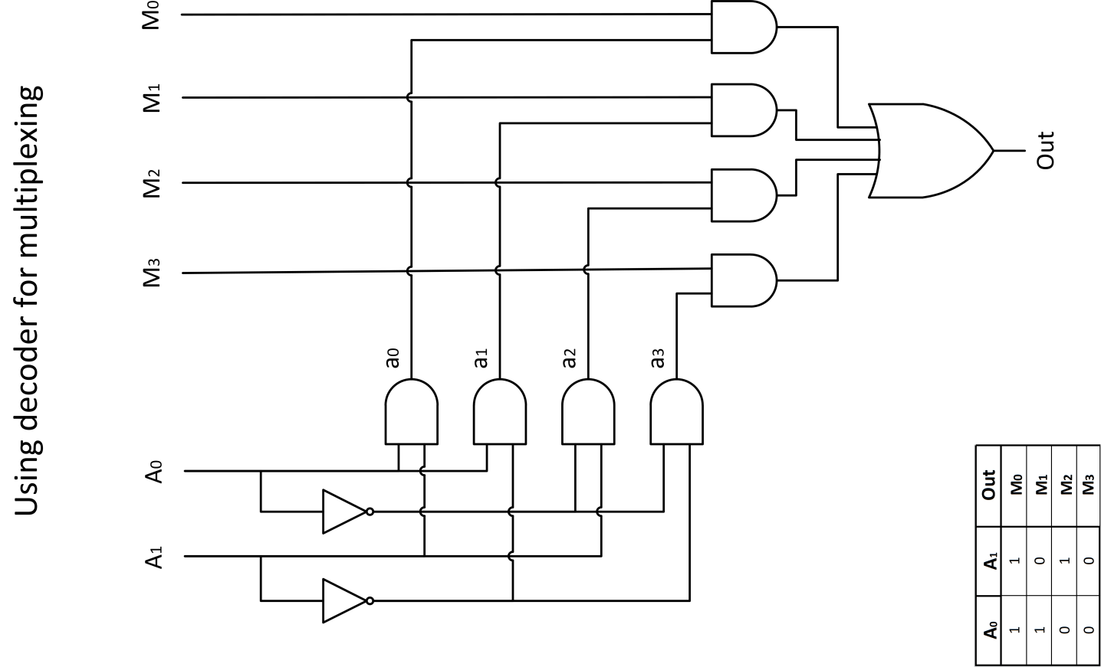
Example of critical path finding: Multiplexer

Slide 16
Thank You Q/A

